Slide 1

Unmasking Fake News: Fighting Misinformation in the Digital Age
GROUP 01
- PRESENTS -
"Think Before You Click: Stop the Spread of Fake News!" 🚫📰

Slide 2
What is Fake News & Misinformation?
Fake News refers to false or misleading information presented as legitimate news, often created to deceive people, manipulate opinions, or generate profit.
Aspect | Misinformation | Disinformation
Defination | False information spread unknowingly | False information spread deliberately
Intent | No intention to deceive | Intentional deception or manipulation
Example | Sharing an outdated news article without checking | Creating a fake story to mislead people
Source | Often spread by unaware individuals | Created by groups with an agenda
Effect | Causes confusion and misinterpretation | Influences public opinion and actions

Slide 3
Why is Fake News a Problem?
Spreads quickly due to social media.
Creates panic, hate, and division
Affects politics, health, and economy

Slide 4



Causes of Fake News Spread
Role of Social Media & Clickbait
Social media allows instant sharing without verification
Clickbait headlines attract views but mislead readers
Bots and fake accounts amplify false narratives

Slide 5

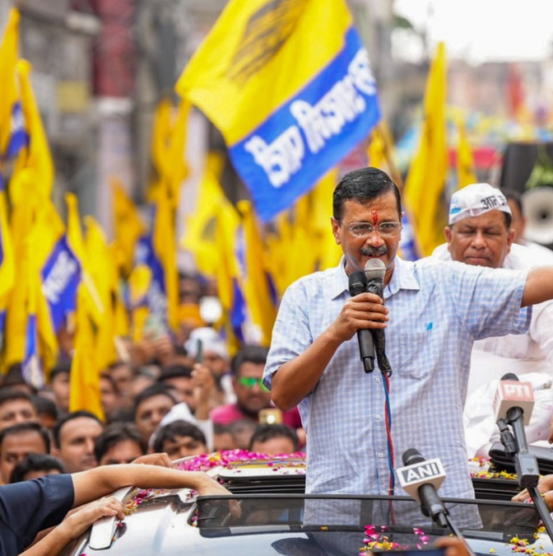
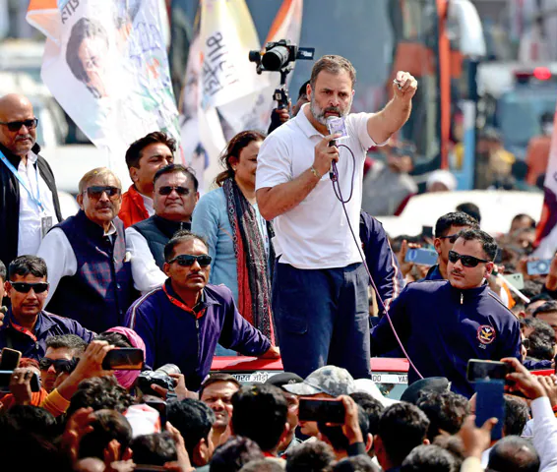
Political, Economic & AI-Driven Misinformation
Used for propaganda and election manipulation
Fake news earns money through ads and views
Deepfakes and AI-generated content make fake news look real

Slide 6
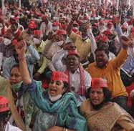
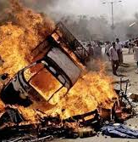
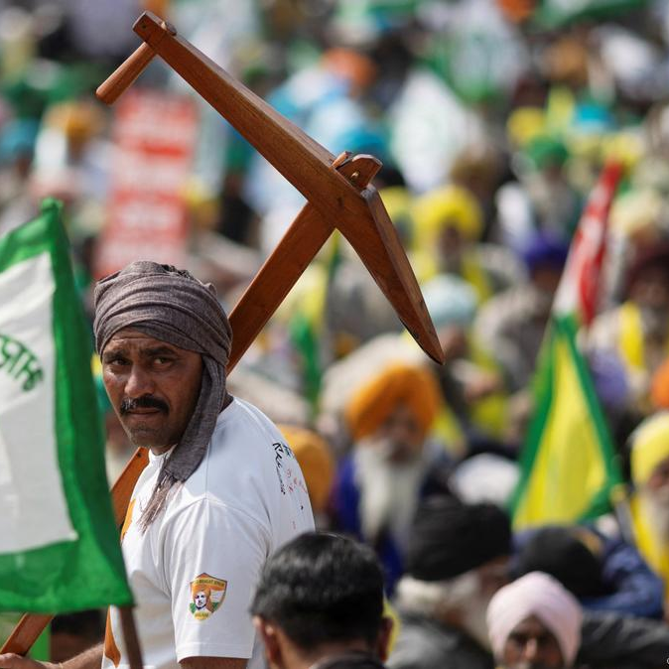

Impact on Society : Social Impact of Fake News
Spreads hate, violence, and fear
Increases racism, communal riots, and conflicts
Influences public opinion in the wrong way

Slide 7
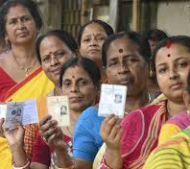
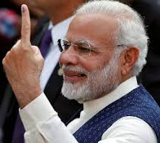
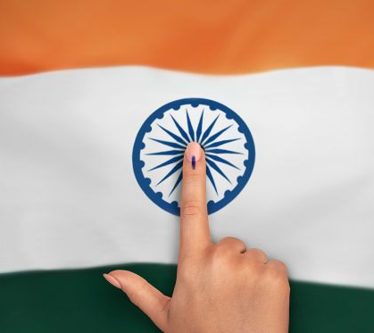
Political Impact of Fake News
Misleads voters during elections
Creates distrust in governments and institutions
Used by political parties to manipulate people

Slide 8

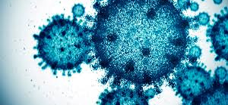
Effects of Fake News in Health Sector
Spreads misinformation about diseases (e.g., COVID-19 myths)
Fake cures and treatments harm people
Vaccine misinformation reduces public trust

Slide 9

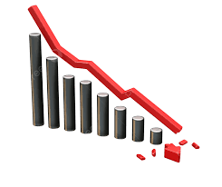
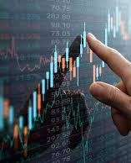
Economic Effects of Fake News
Stock market manipulation with false news
Fake job postings and financial scams
Loss of business reputation due to rumors

Slide 10
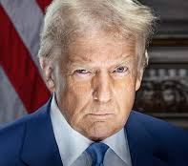
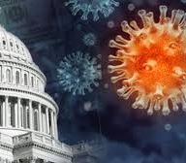
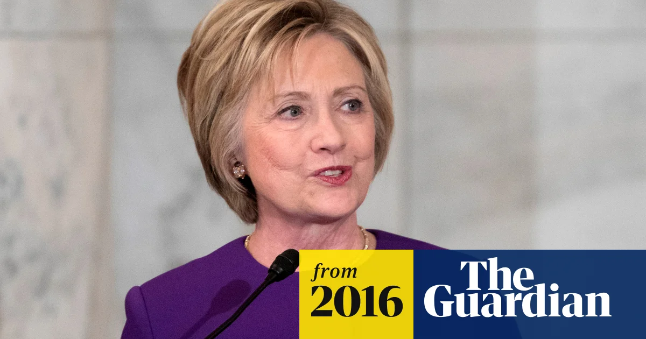
Real-World Examples of Fake News
Political Misinformation Cases
Fake News About EVMs (Electronic Voting Machines) Being Hacked
Fake Photos and Videos During Protests (CAA-NRC & Farmers' Protest)
Fake News on COVID-19 and Government Policies
Brexit Referendum (2016) – Misinformation About EU Payments
2016 U.S. Presidential Election (Russia's Disinformation Campaign)

Slide 11

How to Identify Fake News?
1️⃣ Verify the Source – Check if the news comes from a reliable and well-known media outlet instead of an unknown website or social media page.
2️⃣ Cross-Check with Multiple Sources – Compare the same news on trusted platforms like BBC, The Hindu, or Reuters to see if it's consistent.
3️⃣ Watch for Sensational or Emotional Headlines – Fake news often uses shocking, exaggerated, or fear-inducing titles to grab attention.
4️⃣ Check for Manipulated Images & Deepfakes – Look for inconsistencies in lighting, facial features, or background details in photos and videos.
5️⃣ Use Fact-Checking Websites – Websites like Alt News, Boom Live, and Snopes help verify if a news piece is real or fake.
6️⃣ Be Cautious of Social Media Forwards – Avoid blindly believing or sharing WhatsApp messages, viral posts, or videos without proper verification.

Slide 12
Solutions to Combat Fake News
Role of Government &
Tech Companies
Role of Education &
Media Literacy
1️⃣ Stronger Laws & Regulations – Governments should enforce strict laws against spreading misinformation.
2️⃣ Social Media Action – Platforms must limit fake news, flag false content, and reduce viral forwarding.
3️⃣ AI-Based Fact-Checking – Advanced AI tools should detect and remove fake news before it spreads.
1️⃣ Teach Digital Literacy – Schools should educate students on identifying fake news and reliable sources.
2️⃣ Encourage Critical Thinking – People should verify news, analyze biases, and fact-check before sharing.
3️⃣ Raise Public Awareness – Campaigns on TV, social media, and newspapers should educate people on fake news detection.

Slide 13
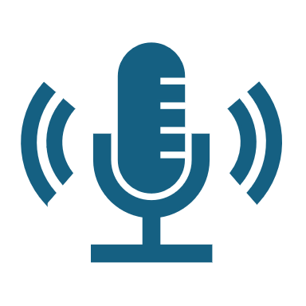
Encouraging Responsible Media Consumption
1️⃣ Verify Before Sharing – Always check the source and credibility before forwarding news.
2️⃣ Follow Trusted Sources – Rely on reputable news agencies instead of random blogs or social media.
3️⃣ Beware of Clickbait & Emotional Headlines – Fake news often uses shocking or misleading titles to spread fast.
4️⃣ Use Fact-Checking Tools – Websites like Alt News, Boom Live, and Snopes help verify authenticity.
5️⃣ Limit Social Media Dependence for News – Cross-check updates with official news platforms.
6️⃣ Educate Others – Spread awareness among family and friends to reduce misinformation.

Slide 14

References
1️⃣ Alt News – (https://www.altnews.in/) – Indian fact-checking website debunking fake news and misinformation.
2️⃣ Boom Live – (https://www.boomlive.in/) – Fact-checking platform verifying viral news and social media claims.
3️⃣ Snopes – (https://www.snopes.com/) – Global fact-checking site analyzing fake news, hoaxes, and urban legends.
4️⃣ FactCheck.org – (https://www.factcheck.org/) – A non-partisan platform that investigates political misinformation.
5️⃣ Google Fact Check Tools – (https://toolbox.google.com/factcheck/explorer) – Helps verify claims with credible sources.
6️⃣ Research Paper: "Fake News Detection on Social Media" – Published by IEEE, discussing AI-based fake news detection techniques.
7️⃣ UNESCO Report on Misinformation – Explores the impact of fake news on society and strategies to combat it.

Slide 15
Thanking you ,
Aastha Sharma (Roll No. – 1)
Abhishek kumar (Roll No. – 2)
Abhishek Negi (Roll No. – 3)
Aditi Juyal (Roll No. – 4)
Aditya Singh Rauthan (Roll No. – 5)
Ajay Singh Negi (Roll No. – 6)
Akanksha Negi (Roll No. – 7)
Akansha Rawat (Roll No. – 8)

